Slide 1
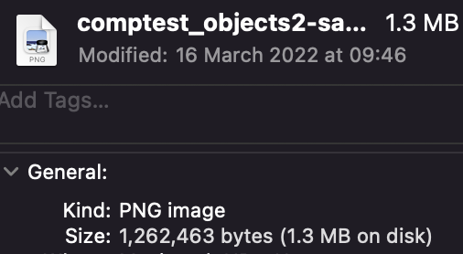
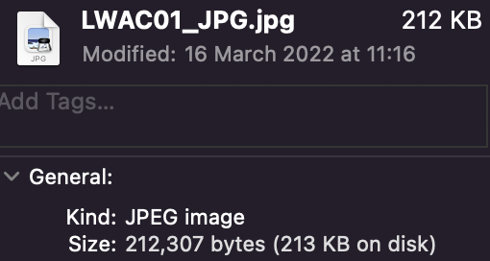
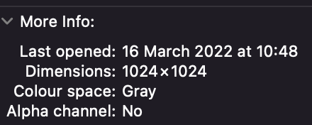
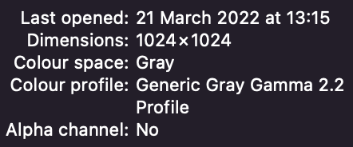
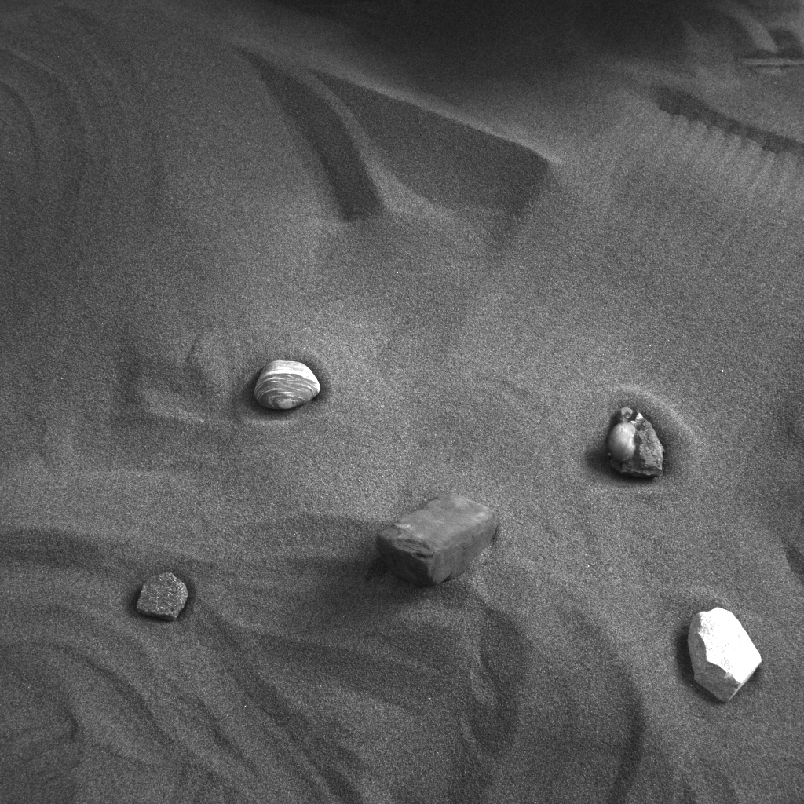
LWAC01 Conversion
PNG
JPG
Size reduced to 16.82% of original size
Grayscale conversion used
MSE = 106.72708225250244

Slide 2
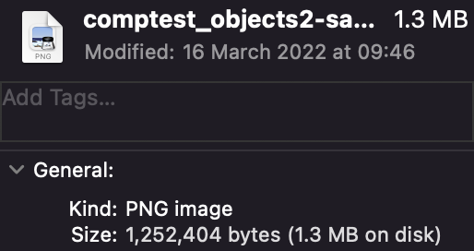
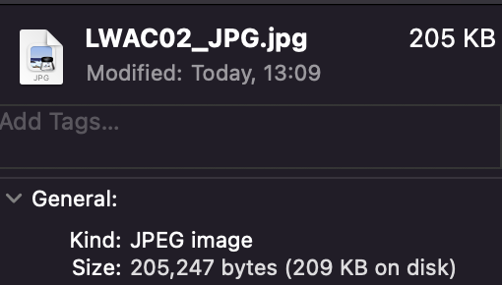
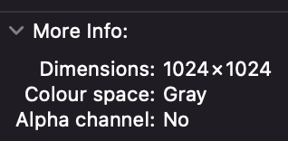
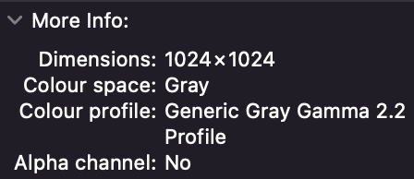
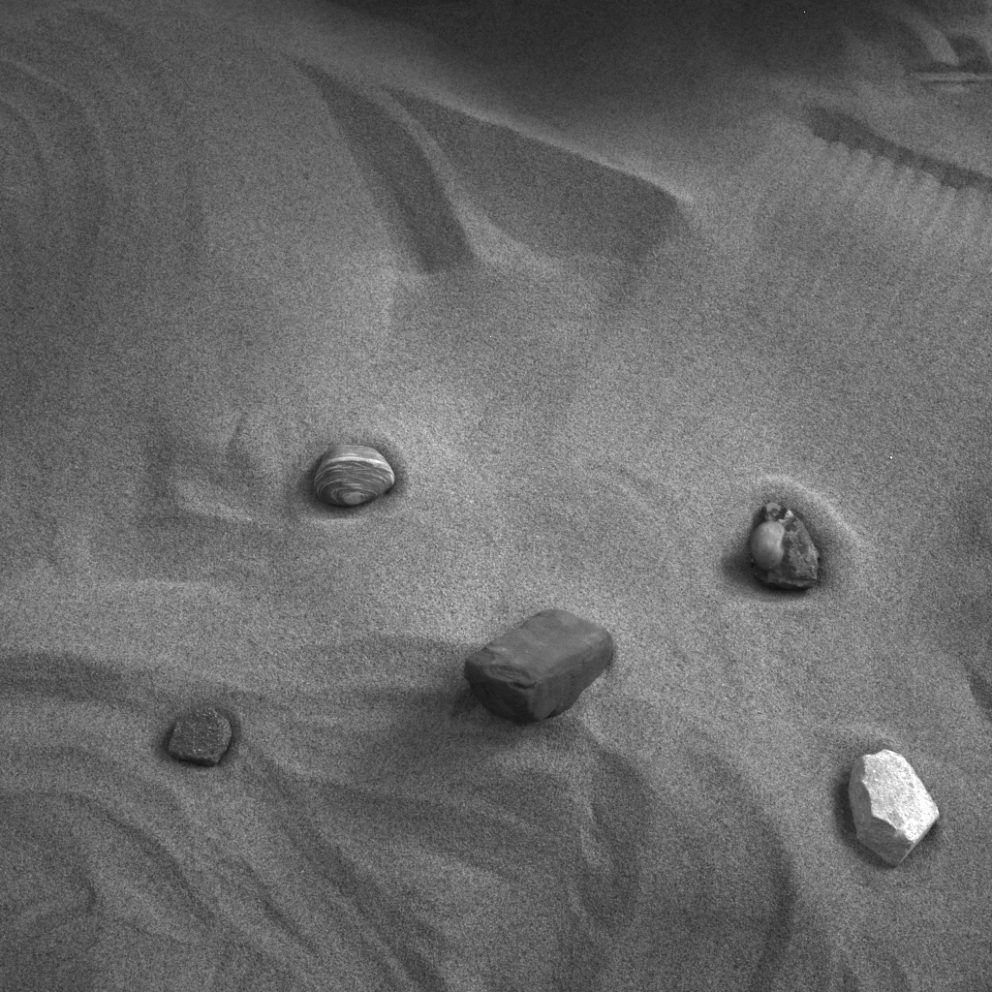
LWAC02 Conversion
PNG
JPG
Size reduced to 16.39% of original size
MSE = 102.48269271850586

Slide 3
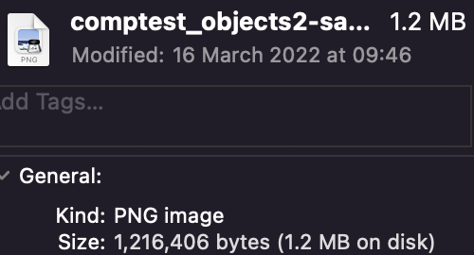
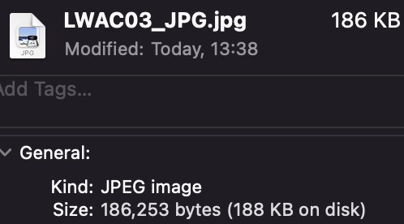
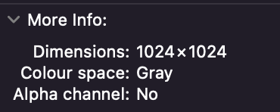
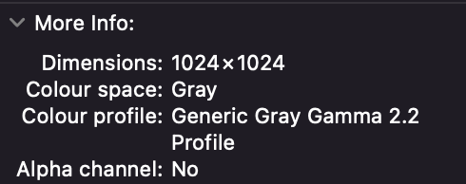
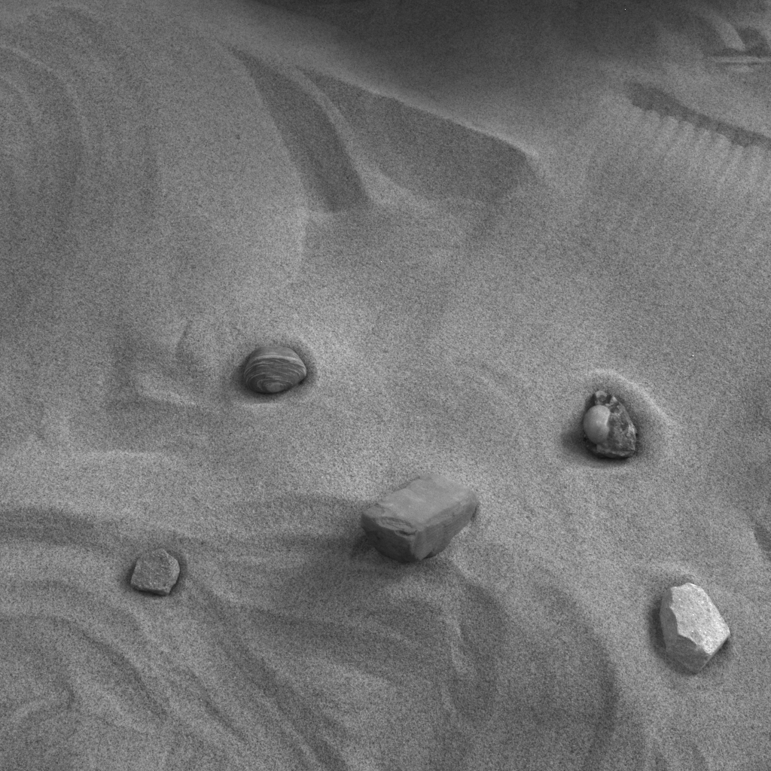
LWAC03 Conversion
PNG
JPG
Size reduced to 15.31% of original size
MSE = 92.70440864562988

Slide 4
IMAGE | PERCENTAGE SIZE REDUCTION | MSE | COLOUR SPACE/PROFILE
LWAC01 | 83.18 | 106.7270822525 | Gray
LWAC02 | 83.86 | 102.4826927185 | Gray
LWAC03 | 84.69 | 92.7044086456 | Gray
Mean Average | 83.91 | 100.6380612055 | NULL
There is no visible differences between the PNG and JPG variants of the images
(This analysis is not scientific)

